Slide 1
RED HAT DECISION MANAGER 7
Business Rules for Digital Transformation
December 2017

Slide 2
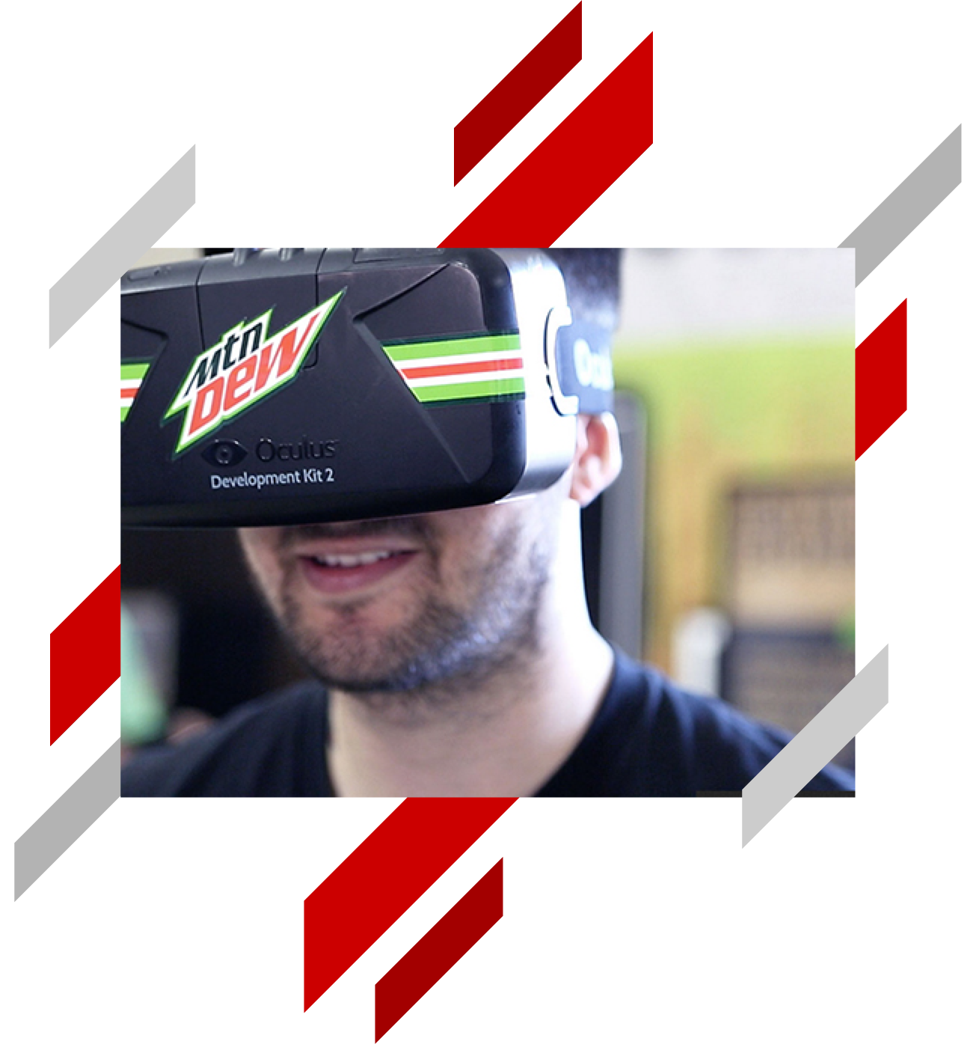

The World is Changing
“
…now we have to compete against new disruptive startups that are hiring kids fresh out of college
drinking loads of Mountain Dew!” — CIO at a global insurer
Notes:
This quote was provided to us by an industry analyst recalling a recent client meeting.
On the face of it, this is a somewhat flippant statement, but when you think about it, it’s actually quite insightful.
What it says is that established organizations with long histories are the most vulnerable to disruption.
This is the problem faced by many of Red Hat’s customers and prospects today.

Slide 3
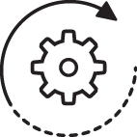


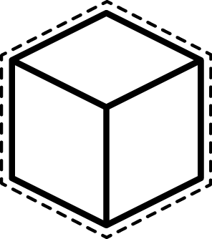

It’s all about Digital Transformation!
Optimize Operations
Empower
Employees
Engage
Customers
Transform
Products
Modernize portfolio, transform processes and skills
Reinvent productivity and enable a data-driven culture
Give them
new experiences they love
Innovate products and business models
Notes:
Source: https://alfapeople.com/uk/digital-transformation-dont-left-behind/
Once you accept that digital transformation is necessary, then transforming and digitizing business operations becomes an essential first step.

Slide 4
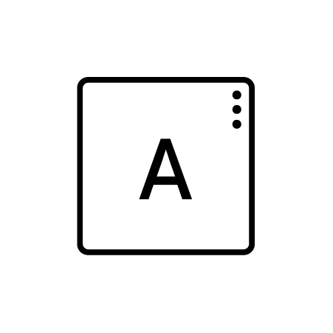
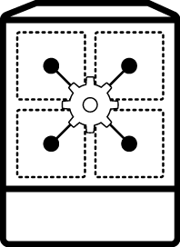



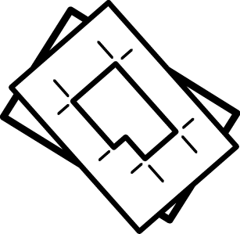



Application Development Must Change
THEN:
NOW:
(Monolithic) Application
Microservices Application
Code
Containers
IDE
Models
Business modeling tool
Developer
Business expert
Developer
Notes:
Here is how things used to be: Developers use an IDE to write, test, debug, etc. code. When ready that code is rolled out into production. Then developers tweak it to make it better. We sometimes use the term ‘monolithic’ to describe these applications. Just means they usually end up being large, unwieldy, hard to understand and difficult to change.
Digital transformation means we have to do things differently. There are two differences in this illustration on the right.
Firstly, a bunch of new approaches and technologies are tackling the ‘monolithic problem’. Like containers, microservice architectures, clouds. I’m sure you’ve probably heard a lot about these from us already. But these are really just a way to make IT do its original job better.
The second, and more important, change is in the lower part of this illustration. Applications are constructed by developers and business people working together. Each contributing their own unique expertise to create apps that will engage customers and drive revenue. Each uses tools and technology tailored to their skills to create the ‘code’ that will become the application. Tools for business experts to build apps are still relatively new, and based on earlier technologies like business process management, business rules management, etc. But the result is a model of business processes and decisions that can be combined with code from developers (providing data access, integration, etc.) to create the app. We call this new approach to app development “process-driven” as it relates to the central role of modeling business processes to build apps.

Slide 5
BUSINESS RULES
Application Development for Business Users

Slide 6
Topics
Business rules overview
Red Hat solutions for developing rules-driven applications
What makes Red Hat solutions different?

Slide 7

EVERY ORGANIZATION MAKES OPERATIONAL DECISIONS

Slide 8
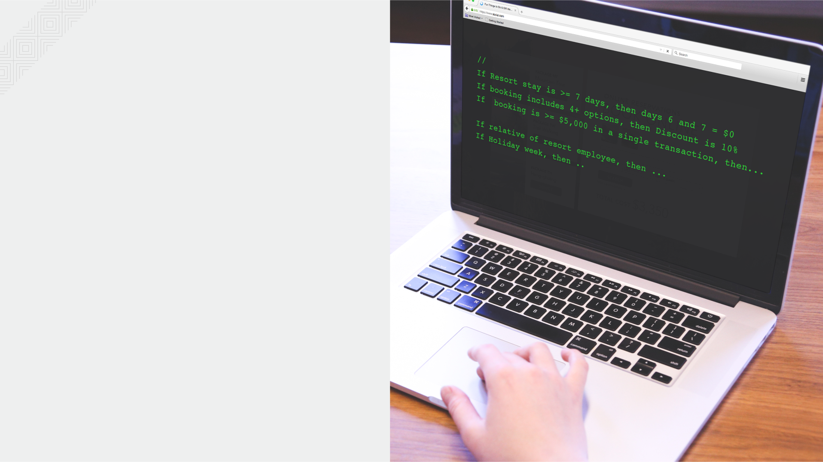
OPERATIONAL DECISIONS ARE GUIDED BY BUSINESS RULES

Slide 9
BUT…
Rules in peoples’ heads
Rules embedded in application code
HOW DO WE KNOW WHAT THE RULES ARE?
WHAT HAPPENS WHEN POLICIES OR RULES CHANGE?
HOW DO WE KNOW THAT RULES ARE APPLIED CONSISTENTLY?

Slide 10


RULE-DRIVEN APPLICATIONS
Applications that automate operational decisions can be built entirely from business rules.
Advantages:
Visibility – everyone can see and understand the business rules
Agility – Rules can be more easily changed than code
Accessibility - business users can fully contribute to the development of rule-driven applications
RULES
Pricing Service
CUSTOMER

Slide 11
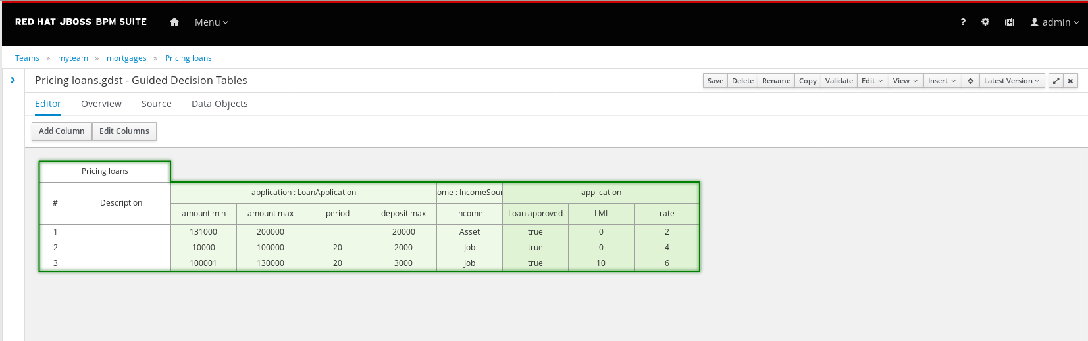
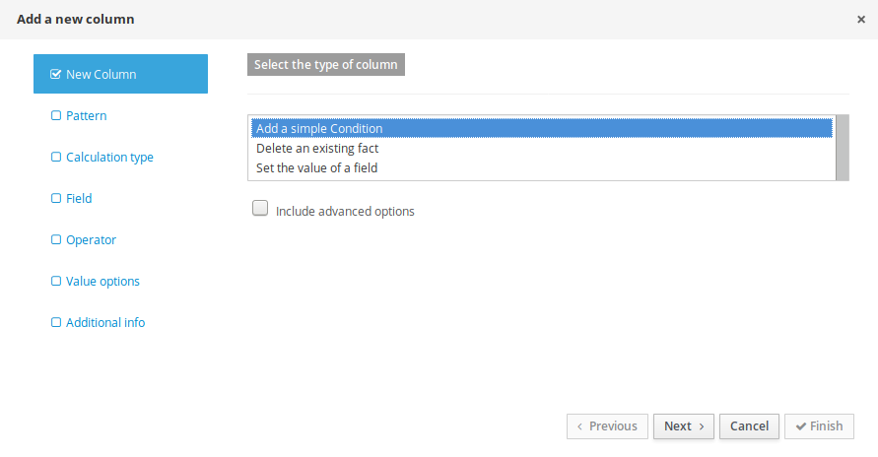
WHAT DO RULES LOOK LIKE?
Decision Tables

Slide 12
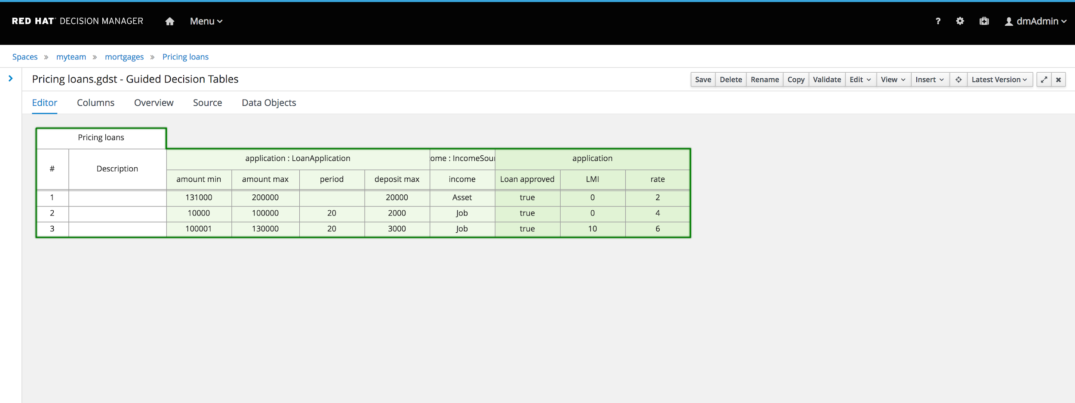
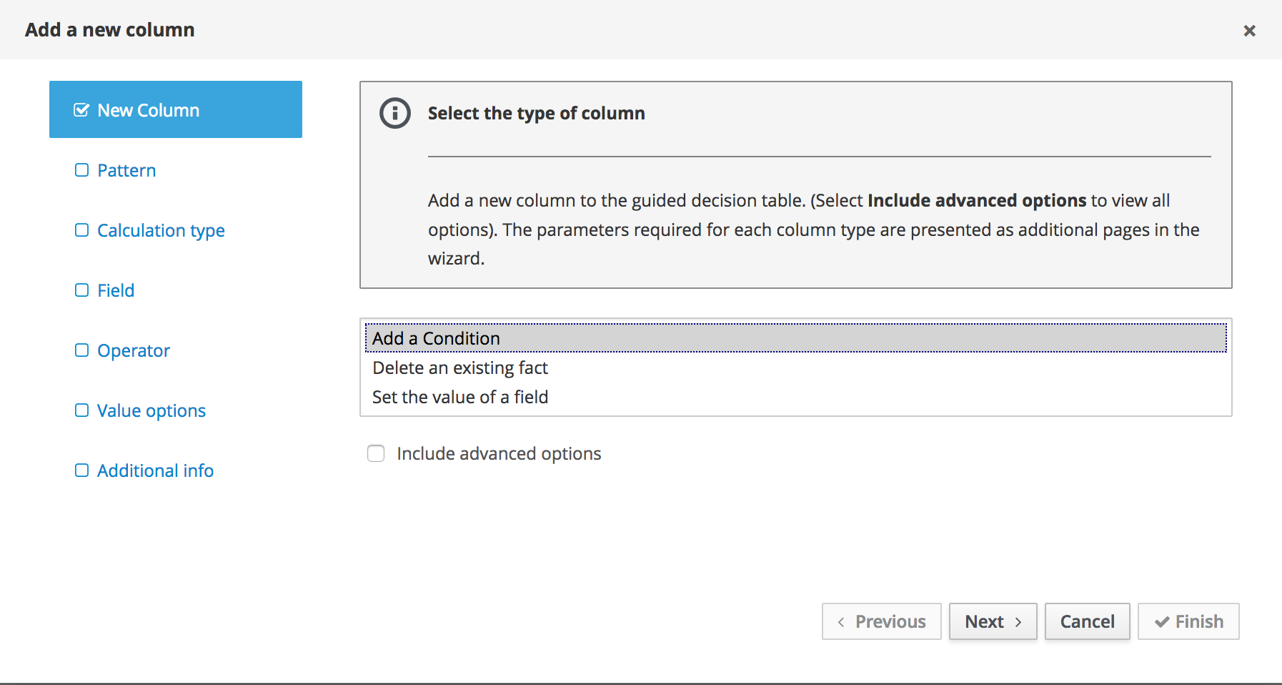
Fit & Finish
Tools for Business Experts: New Decision Tables

Slide 13
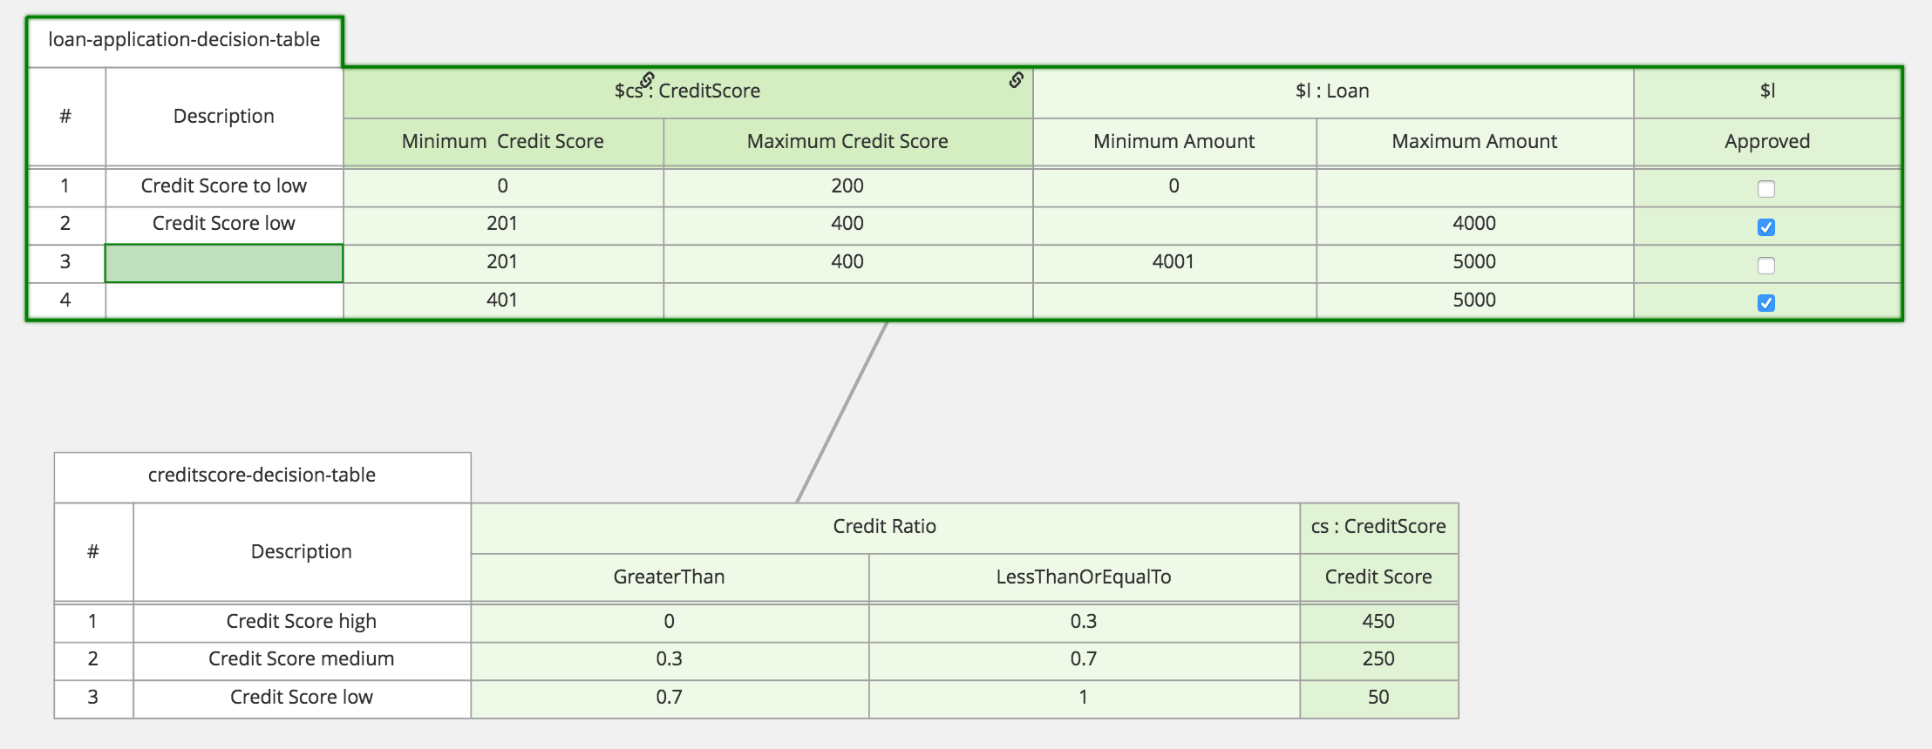
WHAT DO RULES LOOK LIKE?
Decision Graphs

Slide 14
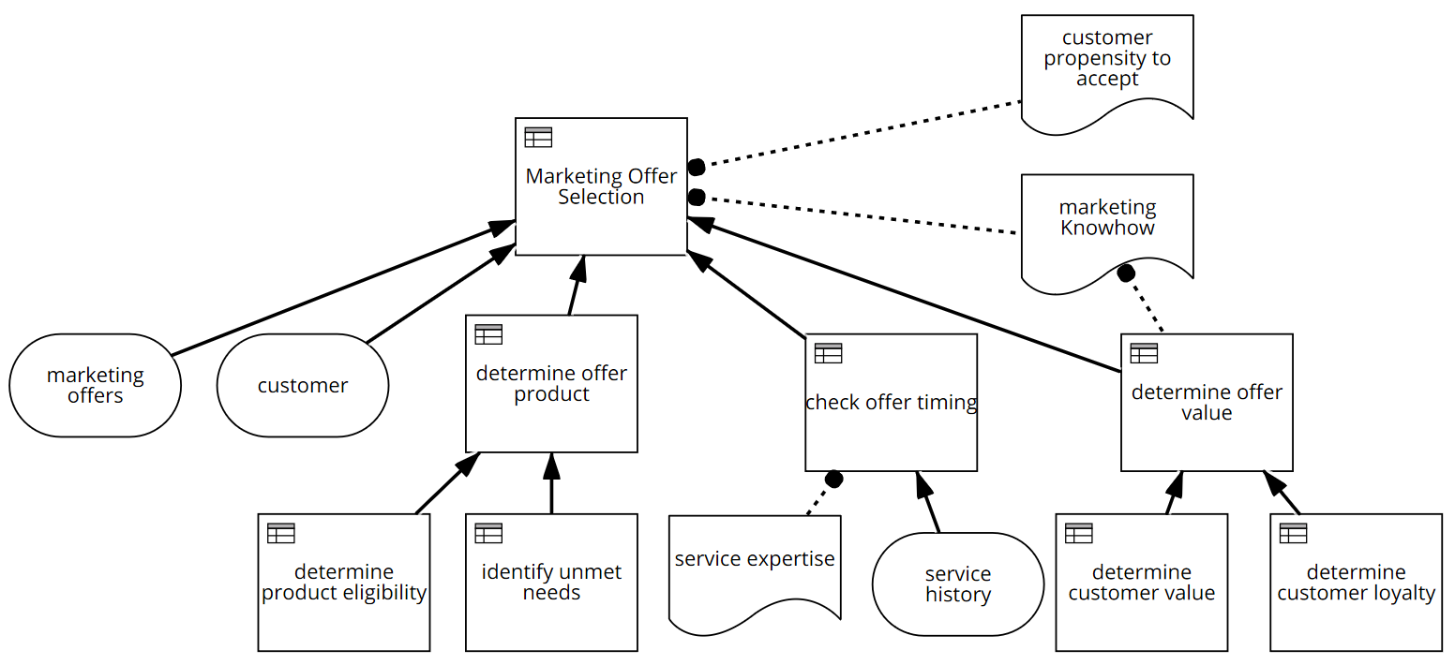
WHAT DO RULES LOOK LIKE?
Decision Model and Notation (DMN)

Slide 15
DEVELOPING RULE-DRIVEN APPS WITH RED HAT

Slide 16




RED HAT DECISION MANAGER
A platform for creating and running decision services
Tools for
business experts
Apps
Client
app
Tools for
developers
Repository
Decision Services
DECISION CENTRAL
DECISION SERVER
Notes:
This is RHDM. (Describe components - repository, tools, runtime). It enables developers to create apps that automate business decisions based on business rules. (e.g., product pricing) When built, business users can take over maintenance of the rules.
Note: Name changing to Red Hat Decision Manager

Slide 17
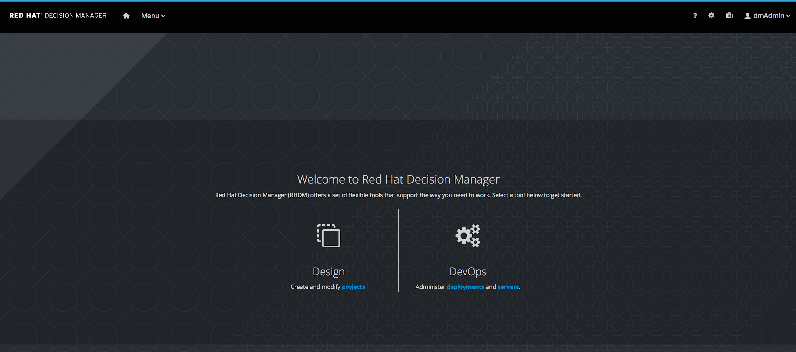
RED HAT DECISION MANAGER WORKBENCH
Decision Central

Slide 18
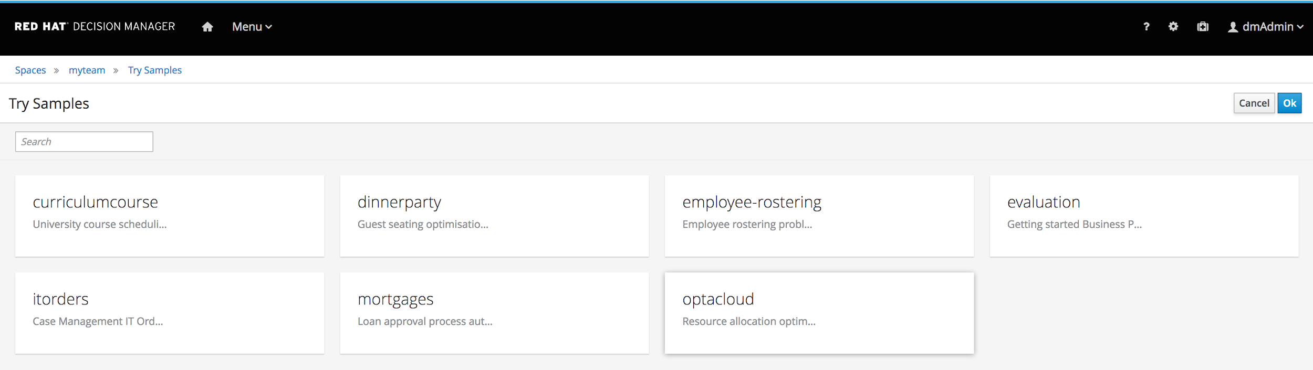
RED HAT DECISION MANAGER QUICK-STARTS
Examples & Templates

Slide 19
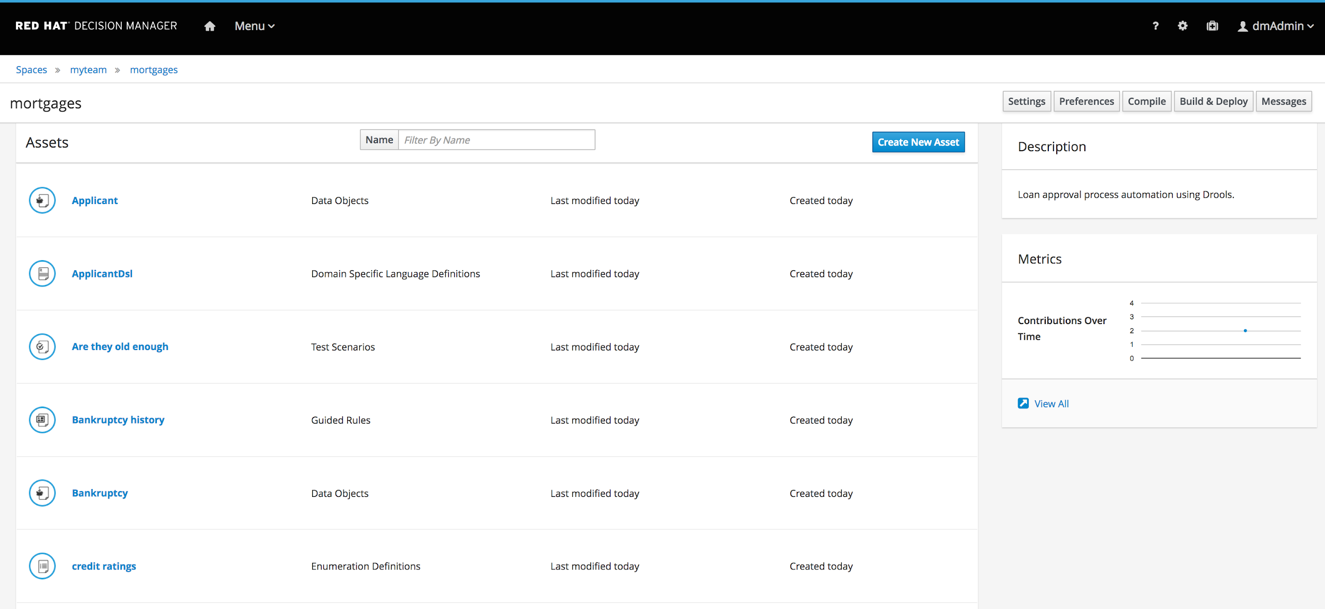
RHDM ASSET MANAGEMENT (Project View)
Library View

Slide 20
THE RED HAT DIFFERENCE

Slide 21
APPLICATION DEVELOPMENT IS COMPLEX
There’s more to an application than decision logic
Applications have to meet requirements for:
Security
Scalability
Interoperability
Application development must be governed by IT practices
Microservices Application
Containers
Models
Business modeling tool
Business expert
Developer

Slide 22



RED HAT’S SOLUTION WORKS FOR BUSINESS AND IT
Red Hat brings business and IT together so that they can each contribute their unique expertise to create modern business applications.
Notes:
But what makes Red Hat’s solutions really different?
While there are similar offerings in the market, some of which even share our open source heritage, it’s the breadth and depth of Red Hat's portfolio, especially the marriage with OCP that makes us clearly different.
Red Hat’s core competency is that we understand how software gets built today, and how it will be built in future. All that knowledge and experience is realized in OpenShift.
The combination of Red Hat Middleware and OpenShift enables process-driven applications to be built using modern DevOps techniques, to take advantage of CI/CD pipelines, and to take advantage of microservices architectures and container technology.
Resulting applications benefit from OpenShift’s resilience, security and scalability—ensuring that process-driven apps can scale to internet scale (OpenShift pods and dynamic, on-demand, automatic scaling), and protect critical systems and information (Red Hat SSO, API Management).
No one else can do this.

Slide 23
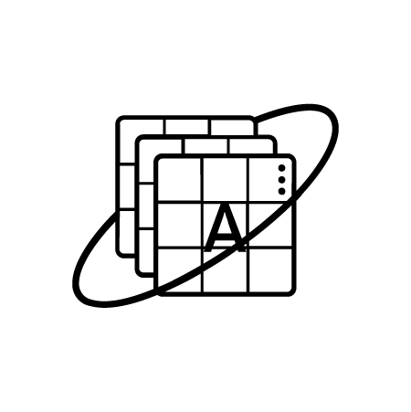
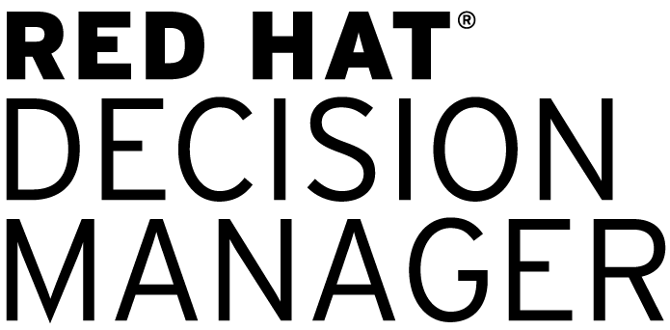


HERE’S HOW IT WORKS
Business experts
Decision Models
Microservice images
Containers
Microservices Application
Developers

Slide 24


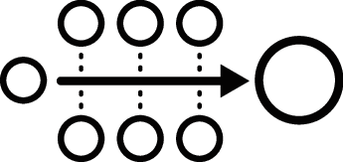








A MICROSERVICES APPLICATION
Event processing
Planning service
MODERN USER EXPERIENCES
Decision service
Analysis service
(Including devices, services, and web applications)
Microsoft Azure
Google Cloud Platform
Amazon Web Services
Notes:
Modern applications are comprised of independent microservices
Microservices are packaged into containers, so they can run anywhere

Slide 25




Benefits of Red Hat’s approach
INCLUSIVE • Build microservices directly from decision models
• Business and IT contribute as equal partners
• Business directly accountable for the business logic
OPEN
• Uses standard repositories and tools that integrate with
existing software development environments
• Complies with standard IT development practices
MODERN • Supports development of containerized microservices applications • Deploy on public, private, or hybrid clouds
Notes:
Enables equal partnership between business and IT. If the the app gives away free product - business is accountable. If records disappear unexpectedly from the database, IT is accountable.
Business and IT can independently maintain their parts of the app
The app is constructed according to IT’s governance policies. It is secure, scalable, etc

Slide 26
THANK YOU
plus.google.com/+RedHat
facebook.com/redhatinc
linkedin.com/company/red-hat
twitter.com/RedHatNews
youtube.com/user/RedHatVideos

Slide 27
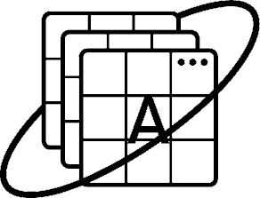

KEY TECHNOLOGIES
Order Service
Stock Service
Modern applications are comprised of independent microservices
Microservices are packaged into containers, so they can run anywhere
Pricing Service
(Rules)
Promotion Service

Slide 28




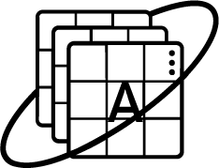

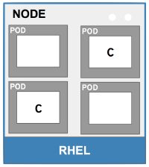







HERE’S HOW IT WORKS...
Dev
S21
Microservice image
Deploy
Source
Image stream
Container image
Dashboard
Business central
Registry
Ops
Notes:
Here’s how modern DPA apps get built. Because all of our tools use common infrastructure (git, Maven, Jenkins, etc.) all the artifacts produced by BPM Suite, Red Hat Mobile, BRMS, can be fed directly into the OpenShift CI/CD pipeline, where they are built into containers and can be deployed as part of a microservices-based application.
Note that although this architecture is possible today, with v6 of BPM Suite and BRMS, it will likely require expertise from Consulting or a partner to set it up correctly. BPM Suite and BRMS v7 will integrate seamlessly with the OpenShift continuous delivery pipeline.

Slide 29


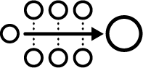











A MICROSERVICES APPLICATION
Process
application
Planning
microservice
Decision
microservice
Mobile
microservice
Notes:
The resulting MSA application is scalable, easily updated, and can run anywhere in private, public and hybrid clouds. It can support modern user experiences, including mobile and voice, and SaaS applications, via extensive standards-based APIs, which can be managed and protected by Red Hat’s 3Scale API management platform.
Note that architectures without OpenShift are also fully supported. Process and decision applications can be deployed in traditional on-premise environments.

